Slide 1

MEDICAL RECORDS MINI PROJECT USING BLOCKCHAIN
SRM INSTITUTE OF SCIENCE AND TECHNOLOGY
FACULTY OF ENGINEERING AND TECHNOLOGY
DEPARTMENT OF DATA SCIENCE AND BUSINESS SYSTEMS
18CSE344T – Final Project Review
TUSHAR / Reg No:2011050010060
ANIRUDH/ Reg No:2011050010064
Guide name: Dr. SV. SHRI BHARATHI
Designation: Assistant Professor /DSBS

Slide 2
Introduction
Abstract
Objective
Tool used
Explanation about the tool
Algorithm
Architecture diagram
Description of algorithm
Modules
Experimental Results
Output Screen Shots
Coding
Reference Papers

Slide 3
INTRODUCTION
Electronic Health Record (EHR) systems [1] have been increasingly used as an effective method to share patients' records among different hospitals. However, it is still a challenge to access scattered patient data through multiple EHRs because existing EHRs are regionally limited or belong to affiliated hospitals.
the main barrier to access patient records lies in the difficulty to find provider's addresses. So far, there have been several projects to overcome these problems; however, the solutions they have produced are difficult and involve redesigning or upgrading of existing EHR systems, which would require substantial expenses.

Slide 4
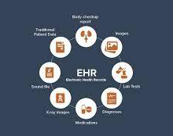

3. one of the most actively ongoing programs is run by CommonWell Health Alliance in the United States, a nonprofit association.
4. a centralized architecture has some drawbacks that it may face the risk of single-point-of-failure and bottleneck of data flow when the system becomes larger.

Slide 5
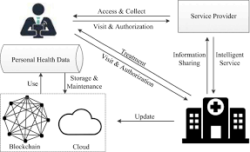
ABSTRACT
Electronic Health Record (EHR) systems are increasingly used as an effective method to share patients' records among different hospitals.
We apply consortium blockchain to compose a distributed system using Hyperledger Fabric incorporating existent EHRs.
To protect a patient's privacy, we use a proxy re-encryption scheme when the data are transferred.

Slide 6

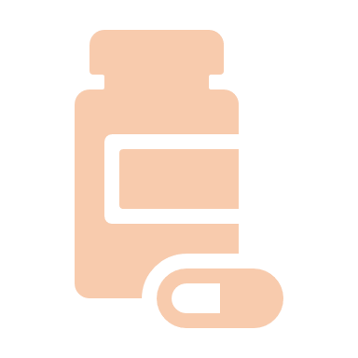
METHODS OF IMPLEMENTATION
Existing System:
In the existing system the records are stored and maintained under the organization. So that, the patient can’t able to access these records for further references. When the particular server(database) gets crashed then all the records will be spoiled. To overcome these drawbacks the proposed system is 0developed.
The patient should have right to access his EHRs for managing and sharing them independently Institutions, etc.

Slide 7
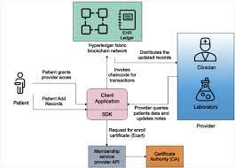
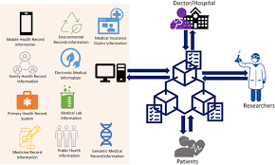
PROPOSED SYSTEM:
The patient should have right to access his EHRs for managing and sharing them independently. The patient can be access his medical report directly and can use the digitalized report with anyone.
By storing the data in the blockchain the user’s data is encrypted and stored as blocks in the etherscan. The user stores data by two way authentication process such as getting secret key generated by the Metamask. Electronic Health Record Systems are proprietary that is centralized by design.

Slide 8
ALGORITHM
Step 1:
Users upload medical records to IPFS.
Upload(Medical Record)→IPFSUpload(Medical Record)→IPFS
Step 2:
IPFS translates medical records into a hash address according to its operational mechanism.
IPFS(Medical Record)⟶translatehashIPFS(Medical Record)⟶translatehash
Step 3:
Send the hash address to the blockchain.
Send(hash)→blockchainSend(hash)→blockchain
Step 4:
Save medical information to the SDB and ledger by running the smart contract RSC.
Run(RSC)→{SDB, ledger}

Slide 9
Algorithm 1 Smart Contract for Patient Records Assign Roles: function Define Roles (New Role, New Account ) add new role and account in roles mapping end function Add Data: function Add Patient Record ( contains variables to add data ) if ( msg.sender = = doctor ) then add data to particular patient‟s record else Abort session end if end function Retrieve Data: function View Patient Record ( patient id ) if ( msg.sender = = doctor || patient) then if ( patient id) = = true then retrieve data from specified patient ( id ) return (patient record) to the account that requested the retrieve operation else Abort session end if end if end function Update Data: function Update Patient Record ( contains variables to update data ) if ( msg.sender = = doctor ) then if ( id = = patient id && name = = patient name )
then
update data to particular patient’s record
return success
else return fail
end if
else Abort session
end if
end function
Delete Data:
function Delete Patient Record ( patient id )
if(msg.sender = = doctor ) then
if ( id = = patient id ) then
delete particular patient‟s record
return success
else return fail
end if
else Abort session
end if
end function

Slide 10
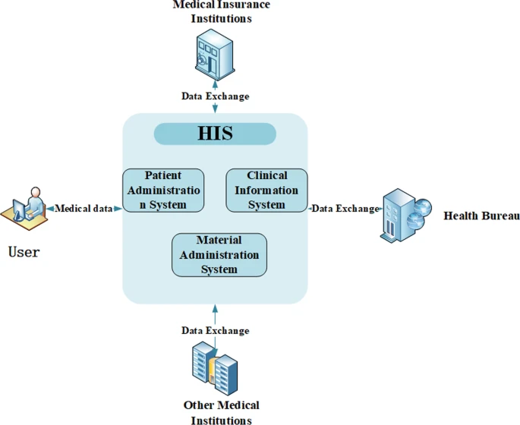

Slide 11
MODULE DESCRIPTION
Modules present in the proposed system are
Ethereum
Smart Contract
Frontend Contract

Slide 12
ETHEREUM
Ethereum is smart contract platform that is inspired by block chain technology. Its elemental unit is called ether. Ether, similarly to bitcoin is divisible up to 10-18, its smallest subunit is called wei. Due to the fee-by-computation18 policy, Ether is sometimes referred as the fuel of Ethereum. The intention of Ethereum is to merge together enhanced scripting possibilities, meta protocol and time stamped database to allow development of an arbitrary application. The key difference from other block chain protocols is built-in programming language, various types of accounts and unlimited variation of application that can be built on top of it.

Slide 13
SMART CONTRACTS
Smart contract are known as the piece of code that is used to perform any task on the blockchain. This piece of code is executed when the users send the transactions . They run on the blockchain directly thus making themselves secure from any kind of tampering and alterations. Smart contract commonly use solidity language and they can be used to program any kind of operation that a programmer wants to do on the blockchain. After programming the required operations the programmers can compile them by using EVM bytecode that would be explained in next section. And after compiling them it could be executed and deployed on the Ethereum blockchain.The programming language of JavaScript and Python are encapsulated with the Solidity language provided by Ethereum to write code in smart contracts.

Slide 14
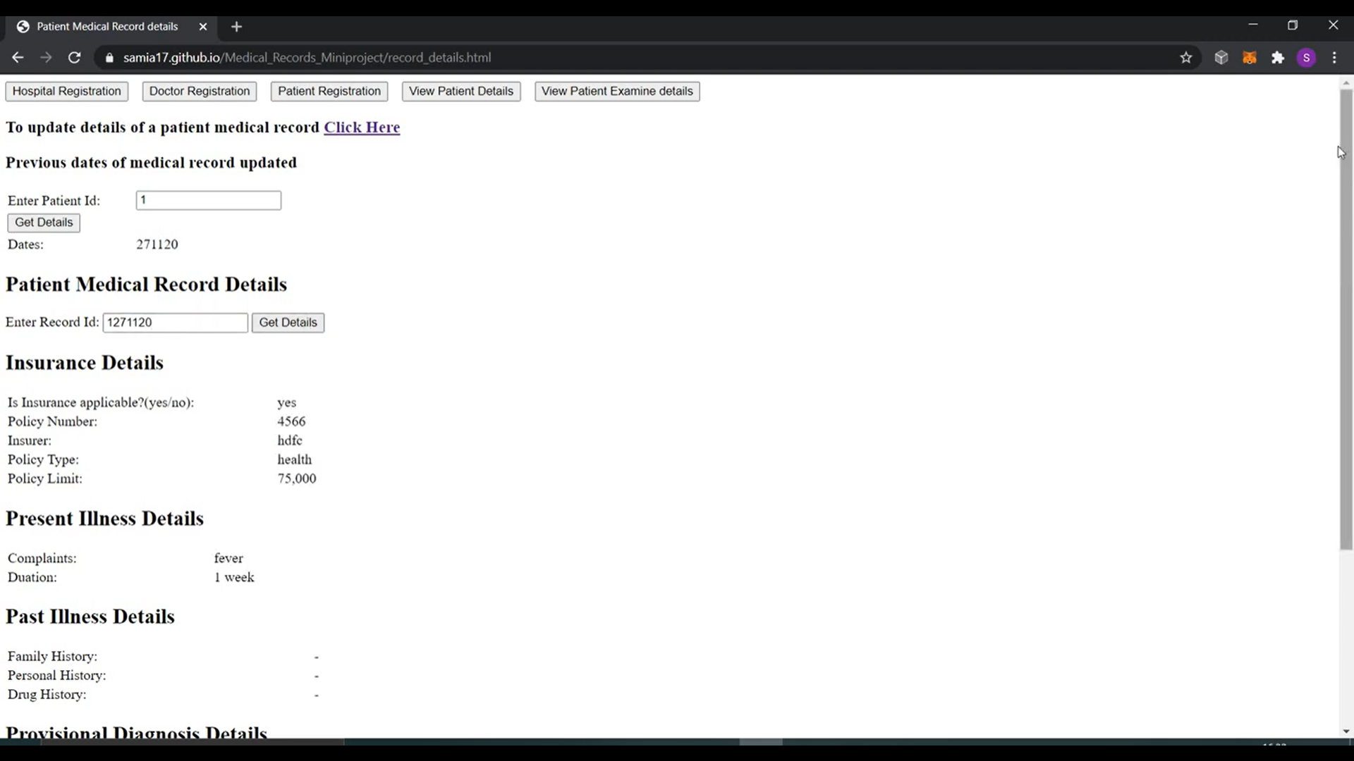

Slide 15
REFERENCE PAPER

Slide 16
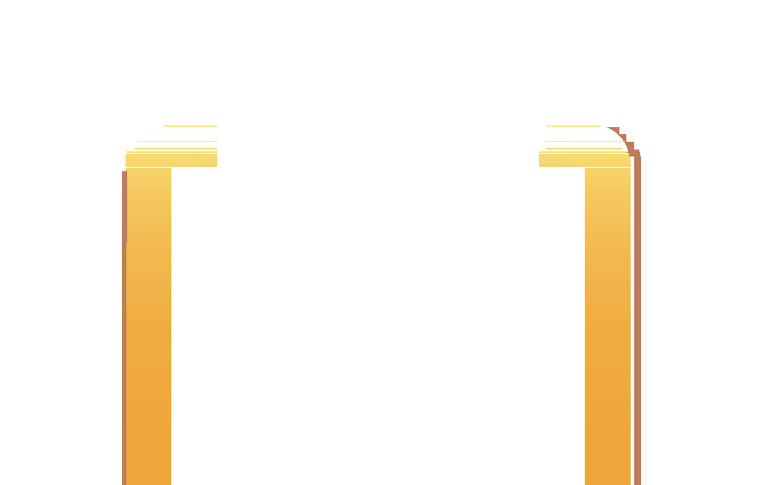








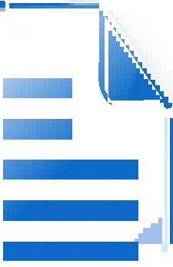
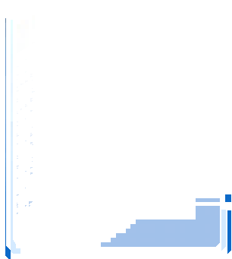







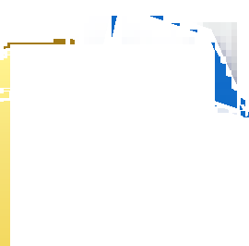
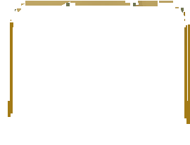

Proceedings of the Third International Conference on Trends in Electronics and Informatics (ICOEI 2019) IEEE Xplore Part Number: CFP19J32-ART; ISBN: 978-1-5386-9439-8
Harshini V M, Shreevani Danai, Usha H R, Manjunath R Kounte
School of Electronics and Communication Engineering REVA University, Bangalore, India
Abstract—The world is moving towards progress, to achieve the desired progress, the world should have a healthy population and health records are the projections of an individual’s health over time. The centralised approach of maintaining the health records lead to data breaches. According to 2017 Ponemon Cost of Data Breach Study, the cost of the data breach for healthcare organizations estimated to be $380 per record. According to 2016 Breach Barometer Report, 27,314,647 patient records were affected. So we moved towards institution-driven approach of record maintenance, which didn’t make much difference with the previously existing one. Since the patient have no control over the data, the chances of data being misused is high. So we need a patient-centered approach which is completely decentralised, which can identify data thefts, prevent data manipulation, and patient has the right in access control. Blockchain Technology serves as a best solution to address all the problems and fulﬁll the needs. Blockchain being a decentralised and distributed ledger it can also impact on billing, record sharing, medical research, identify thefts and ﬁnancial data crimes in days to come. Implementation of smart contracts in health care can simplify things even better. Where invoking, record creation and validation will be done on Blockchain.
This paper highlights on the patient-driven model of record
maintenance using Blockchain technology where smart contracts can be incorporated in future days
making it more potential in data exchange. Finding its huge
scope, hoping that more researches will be carried out and practically implemented.
Index Terms—Decentralized, Blockchain, Immutability, Cryp-
tographic hash, Smart contract
I. INTRODUCTION
Better health is important to human happiness and the welfare of society. It plays a vital role in the economic progress of the nation. Ill health, casualty, emergencies occur every day and the diseases are expected to be diagnosed and treated. A health record is a collection of clinical data related to the patient’s mental and physical health, gathered from different sources. Health record consists of a patient’s medical history, examination, diagnosis, treatment, results of lab investigation, scanning reports, alerts like allergic to etc. These health records can be managed both manually and digitally.
The traditional method which is followed in most of the
hospitals for maintaining records is the manual method which includes papers and books[13]. This method has serious lim- itations such as a need for large storage areas and retrieval of records is difﬁcult. In the present era computerization[2] of clinical records has become popular as the storage and retrieval of the records is easy. However, the chances of manipulation
Chart preparation and Daily Schedules
Cash/Cheque payments
Inquiries, Remainders And appointments
Receptionist
Diagnostic documentation, Filing Updates
Claims
Orders:Referrals, Rx Tx, Lab fax
Fig. 1. Existing centralized healthcare model
without identiﬁcation has become a serious concern. Another major perturb is the maintenance of patient records conﬁ- dentially as the patient can hold the doctor and the hospital irresponsible for breaking the conﬁdentiality of his medical records[6].
Also, paper-based records are often incomplete, giving rise to unwanted repeat testing and medication. There is wastage of time since this system needs more manual power for transferring records by mail or faxes as these are dispersed and are not centralized[8]. Even accessing of medical records by doctors is limited.
Health records can be easily and quickly shared between medical institutions by integrating digital technologies in the healthcare system[17]. In this respect there are intense queries about the storage of patient’s data, providing authorization to access the data, security & immutability of the data[21]. These problems can be solved by developing a decentralized digital health infrastructure that is by integrating Blockchain technol- ogy into the healthcare system[12]. Blockchain technology has the capability to rebuild the modern economy by maintaining and updating records[5].
The rest of the paper is organized as follows:section IIA

Slide 17



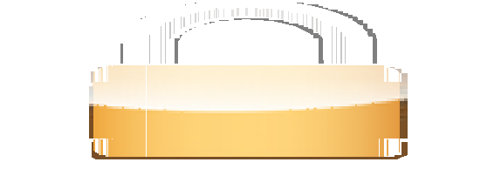




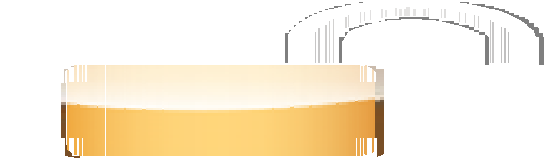
Proceedings of the Third International Conference on Trends in Electronics and Informatics (ICOEI 2019) IEEE Xplore Part Number: CFP19J32-ART; ISBN: 978-1-5386-9439-8
provides detailed description of Blockchain technology,section IIB gives a brief review on existing Blockchain challenges and proposed solutions followed by section III where we have highlighted the medical record management in decentralized manner. Section IV provides some concluding remarks.
II. BACKGROUND
A. Blockchain Technology
A blockchain is a decentralized, distributed, immutable, shared & tamperproof data structure to store a continuously growing list of the transaction[22][9].
Let us consider Blockchain as a register containing trans- action records into timestamp blocks. Each block has its own identity called cryptographic hash[10]. Each block is provided with the hash value of the block that came before it. Because of which a link is established between the blocks, thus creating a chain of blocks. We get a clear picture of how a Blockchain works only when we explore how a Blockchain network runs. It is a peer-peer network where each node holds the record of each transaction that’s been carried out in the network. To carry out transactions each node has its own wallet. The interaction between the user and the network is via a pair of private & public keys(Cryptographic keys)[14]. A private key is used to sign their own transaction whereas the public key is visible to all the nodes in the network[20].Someone who wants to carry out transaction should send a message by signing the transaction with their private key, when this is combined with the public key it forms a digital signature[15]. This transaction is broadcasted onto the Blockchain network where it is veriﬁed by the miners. Miners are the nodes in the Blockchain with high processing power[18]. Miners make the transaction unaltered & irreversible using a consensus algorithm called Proof of work. There is a competition among miners to generate a valid block and the one who generates a valid block is rewarded[16].
A block of the transaction is approved only when it is veriﬁed by all the miners in the network and if more than 50% of the miners validate the transaction then this block is considered as a valid block and is added to the longest Blockchain[19].
B. Literature Survey
In this section, we highlight the various attempts made to safeguard health records, its challenges, and the possible solutions.
Towards using Blockchain technology for eHealth data access management: In the paper entitled ”Towards using Blockchain technology for e-Health data access management” the authors have highlighted the beneﬁts of Blockchain and the speciﬁc problems associated with it for the secure deployment of the health record and it also provides a scalable solution in order to obtain the best performance. They have also proposed an architecture to address-Health application challenges where Doctors and hospitals are considered as nodes which are connected to the eHealth Blockchain with the smart contract even an off-chain database is also maintained[1]. Patient’s can interact with the Blockchain and medical sensors through the data gateway. This paper also proves that with the use of correct tools, models, protocols and the Blockchain technology may fully functional systems are yet to be implemented to revolutionize the future applications.
Decentralized e-Health Architecture for boosting health-
care Analytics: In the paper titled ” Decentralized e-Health Architecture for boosting Healthcare Analytics” authors have summarized the problem integrated with the analysis and security of medical data. They have also tried to provide a solution that improves the quality of medical services. They have proposed a Blockchain solution for state-scale in healthcare which is based on the Exonum framework, which consists of nodes connected through peer-to-peer connections where all nodes are authenticated by using the public key[3]. They have also told that Blockchain will be used to deal with large volumes of clinical data and also to maintain the conﬁdentiality of medical data. One more advantage is Blockchain can be used to create a data-based market where the patients will get a data monitoring tool through which they can participate in medical analytics and if they provide their data to the medical institution, research institutions they can even get rewards.
Blockchain technology: Is this the solution to EMR
interoperability and security issues in developing countries: The paper ” Is this the solution to EMR interoperability and security issues in developing countries” tells that the use of Blockchain in EMR safeguards continuous availability and access to real-time data. Taking the case study of EMR in Kenya, the authors have discussed the existing method of maintaining the health record and they have highlighted the importance of Blockchain technology as it increases the interoperability and security of the system. Blockchain helps the patient to have full access to the data and control on how data is shared. Further Blockchain depends on cryptographic
Sender makes a transaction
Creation of block
Encryption
Receiver receives the transaction
Decryption
Validation
Fig. 2. Working of Blockchain Technology

Slide 18
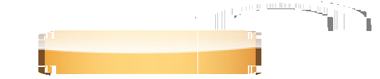



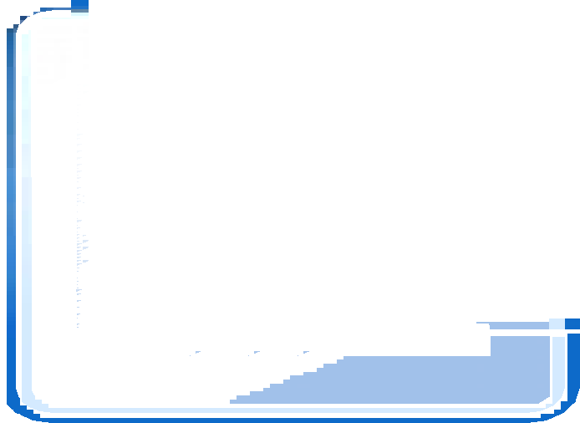
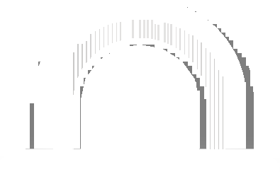
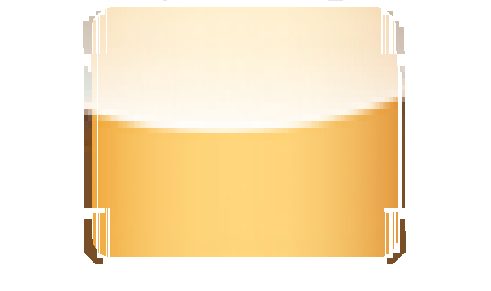













techniques to interact in a network without preexisting trust between the parties[6]. When the patient’s information is passed between stakeholders, the patients’ privacy is preserved because of the encryption of information.
d) Introducing Blockchain for Healthcare: In the paper titled ”Introducing Blockchain for Healthcare,” the authors have focussed on different Blockchain structures, existing challenges of Blockchain and the possible solutions. Even though Blockchain is used to create smart contracts between healthcare providers[7] and to provide access to certain data or patient records there arises a problem that who is accessing the data and the person who is accessing is authorized to do so or not. One more security issue is Sybil attack which can be solved by forcing each of the miner nodes to involve themselves in solving a mathematical problem before a new block is added to Blockchain by the attackers[7]. Another issue is the inference of private data because of these issues the author have suggested the scientists come up with new architecture design for Blockchain which does not rely on a current cryptographic algorithm.
III. MEDICAL DATA MANAGEMENT ON BLOCKCHAIN
The modern healthcare system is using digital methods for maintaining patients health records.
Presently healthcare organizations use a centralized method for saving patient’s information, diagnostic reports, and doc- tor’s prescription. Since it is a centralized system there are chances of data getting leaked or exploited for various reasons as patients don’t have control over their data and also ex- changing of the recorded data is time-consuming & a complex process. With the aim of dealing with these problems, we are proposing an idea of switching a centralized system to a decen- tralized system using Blockchain technology. For integrating Blockchain in healthcare, ﬁrstly we need to understand the scope of data and where and how it is being generated. Health- care organizations generate sensitive and critical medical data at every stage of medical treatment like a consultation,
1) Hospitals maintain the patient’s records using Blockchain | 2) | Each patient’s records are stored in blocks using their public keys
3) | 4)
 |  | Patients permit healthcare
Healthcare organizations submit their queries via APl’s |  | organizations to access their medical records by sharing their unique lD’s
to access patients
encrypted data

Slide 19
Proceedings of the Third International Conference on Trends in Electronics and Informatics (ICOEI 2019) IEEE Xplore Part Number: CFP19J32-ART; ISBN: 978-1-5386-9439-8
ACKNOWLEDGMENT
The authors would like to thank Dr P Shyamaraju, Chancel- lor, REVA University for all the facilities provided to carry out the research activities. Also, the authors would like to thank Dr Mohammed Riyaz Ahmed,Chintarlapallireddy Yaswanth Simha, Teja K, M B Sravani of ECE, REVA University for their continuous support and encouragement.
REFERENCES
Riﬁ, Nabil, Elie Rachkidi, Nazim Agoulmine, and Nada Chendeb Taher. ”Towards using blockchain technology for eHealth data access man- agement.” In 2017 Fourth International Conference on Advances in Biomedical Engineering (ICABME), pp. 1-4. IEEE, 2017.
Pramod P, Pratyush Kumar Tripathy, Harshit Bajpai, Manjunath R Kounte, ”Role of Natural Language Processing and Deep Learning in Intelligent Machines”, IEEE International Conference on Electrical, Communication, Electronics, Instrumentation and Computing (ICECEIC), Kanchipuram,
India, 30-31 Jan 2019
Kotsiuba, Igor, Artem Velvkzhanin, Yury Yanovich, Iuna Skarga Ban- durova, Yuriy Dyachenko, and Viacheslav Zhygulin. ”Decentralized e- Health Architecture for Boosting Healthcare Analytics.” In 2018 Second World Conference on Smart Trends in Systems, Security and Sustainabil- ity (WorldS4), pp. 113-118. IEEE, 2018.
Mikula, Tomas, and Rune Hylsberg Jacobsen. ”Identity and Access Management with Blockchain in Electronic Healthcare Records.” In 2018 21st Euromicro Conference on Digital System Design (DSD), pp. 699- 706. IEEE, 2018.
Soumyalatha Naveen, Manjunath R Kounte, Machine Learning based Fog Computing as an Enabler of IoT, International Conference on New Trends in Engineering and Technology (ICNTET), Tiruvalur, Tamil Nadu, India, 7-8 Sep 2018
Kamau, Gabriel, Caroline Boore, Elizaphan Maina, and Stephen Njenga. ”Blockchain Technology: Is this the Solution to EMR Interoperability and Security Issues in Developing Countries?.” In 2018 IST-Africa Week Conference (IST-Africa), pp. Page-1. IEEE, 2018.
Alhadhrami, Zainab, Salma Alghfeli, Mariam Alghfeli, Juhar Ahmed Abedlla, and Khaled Shuaib. ”Introducing blockchains for healthcare.” In 2017 International Conference on Electrical and Computing Technologies and Applications (ICECTA), pp. 1-4. IEEE, 2017
Zhang, Xiaoshuai, and Stefan Poslad. ”Blockchain Support for Flexible Queries with Granular Access Control to Electronic Medical Records (EMR).” In 2018 IEEE International Conference on Communications (ICC), pp. 1-6. IEEE, 2018.
Chintarlapallireddy Yaswanth Simha, Harshini V M, L V S Raghuvamsi, Manjunath R Kounte, ”Enabling Technologies for Internet of Things Its Security issues”, Second International Conference on Intelligent Com- puting and Control Systems (ICICCS 2018), Madurai, India, 14-15 June 2018, pp 1849-1852
Wehbe, Youssef, Mohamed Al Zaabi, and Davor Svetinovic. ”Blockchain AI Framework for Healthcare Records Management: Constrained Goal Model.” In 2018 26th Telecommunications Forum (TELFOR), pp. 420-425. IEEE, 2018.
Novikov, Sergey P., Oleg D. Kazakov, Natalya A. Kulagina, and Natalya Yu Azarenko. ”Blockchain and Smart Contracts in a Decentralized Health Infrastructure.” In 2018 IEEE International Conference” Quality Management, Transport and Information Security, Information Technolo- gies”(ITQMIS), pp. 697-703. IEEE, 2018.
Jiang, Shan, Jiannong Cao, Hanqing Wu, Yanni Yang, Mingyu Ma, and Jianfei He. ”Blochie: a blockchain-based platform for healthcare information exchange.” In 2018 IEEE International Conference on Smart Computing (SMARTCOMP), pp. 49-56. IEEE, 2018.
Azaria, Asaph, Ariel Ekblaw, Thiago Vieira, and Andrew Lippman. ”Medrec: Using blockchain for medical data access and permission management.” In 2016 2nd International Conference on Open and Big Data (OBD), pp. 25-30. IEEE, 2016.
Kaushik, Akanksha, Archana Choudhary, Chinmay Ektare, Deepti Thomas, and Syed Akram. ”BlockchainLiterature survey.” In 2017 2nd IEEE International Conference on Recent Trends in Electronics, Infor- mation Communication Technology (RTEICT), pp. 2145-2148. IEEE, 2017.
Start
No
lnvoker=hospitaladmin
yes
Record Created
lf signcount==O
No | Record already exists
yes
Record signed
lncrement signcount
Emit new record
End
Fig. 4. Flow chart of the smart contract
IV. CONCLUSION AND FUTURE WORK
As an age old saying goes ”Health is Wealth” in the present scenario we can now consider in addition to health, health records are also wealth. So it is more important to keep our health records safe. The world has started moving towards patient-driven interoperability where patients provide the on- demand access to their health records. In this model, the patient is considered as the sole owner to his health records who would decide on sharing what data and with whom. This drift from an institute-driven to patient-driven comes with a bundle of challenges which are effectively addressed by Blockchain by decentralizing the whole mechanism in contrast to the traditional way of data management. 200 health executives were interviewed by IBM’s Institute for Business Value Blockchain, of which 16 percent of people are ready to deploy commercial Blockchain. As discussed above, Blockchain does not just help in decentralizing the data, it also gives the real-time data access, keeps the data conﬁdential, handles high volumes of data efﬁciently, and also authenticate and authorize the data.
Our approach also deploys smart contracts, which is a code, which executes on its own when both the parties agree on the set of protocols. Here we consider Hospital admin as one end user and the patient as another party. There are three steps of executing the smart contract namely, Invoking, Record creation, and Validation. Our paper suggests Blockchain tech- nology as one of the possible solutions for the efﬁcient main- tenance of health records. Blockchain technology’s usecase is not restricted to health record management, it can also be implemented in various domains such as utility payments, banking, e-voting, transport, supplychain management and etc. Further research can help implementation of Blockchain in all domains making the lives easier.

Slide 20
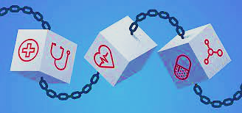
CONCLUSION
In the EHR system the patient can access their report and can use the report for their lifetime with security. The private key is used for the patient which can be used for the further use of the reports. The one who don’t have the private key cannot involve in the process of retrieving data. Hence the Health Records of the patients are more secured with the BlockChain and can used with their own private key as well as they can make use of that for further reference. Currently, there is a huge obstacle for using ethereum platform, which lays in difficulty of obtaining ETH units. The units can be obtained either by mining or purchased for fiat or cryptocurrency like Bitcoin.

Slide 21
Thank You

